Slide 1
College Technical Math 1
Section 4.1
US Customary Units of Measure

Slide 2
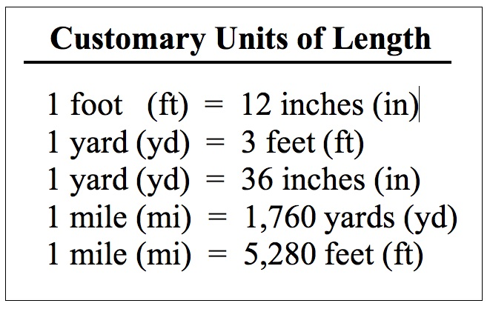
US Customary Units - Length

Slide 3
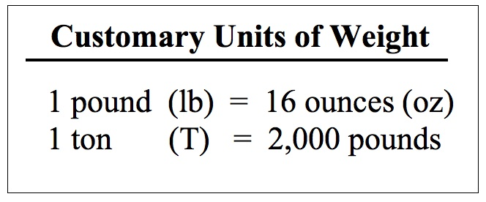
US Customary Units - Weight

Slide 4
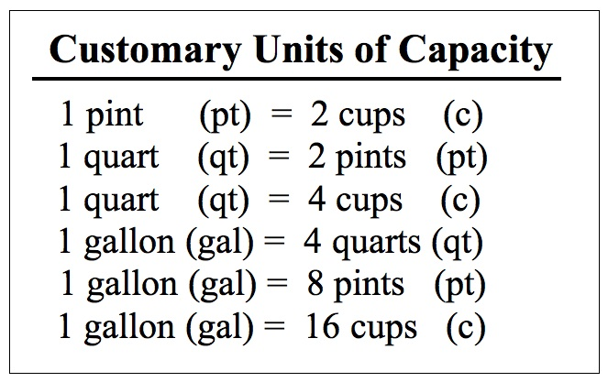
US Customary Units - Capacity

Slide 5
Conversion Ratios
Given the equivalence of any two US customary units of measure, we can create two conversion ratios. These ratios have a value of 1.
Conversion ratios are used to convert between units of measure.

Slide 6
Conversion Ratios
Given that $5280 ft=1 mi$, write two conversion ratios. (Example)
Ratio 1:
$$\frac{5280 ft}{1 mi}$$
Ratio 2:
$$\frac{1 mi}{5280 ft}$$

Slide 7
Conversion Ratios
Given that $8 oz =1 c$, write two conversion ratios. (Example)
Ratio 1:
$$\frac{8 oz}{1 c}$$
Ratio 2:
$$\frac{1 c}{8 oz}$$

Slide 8
Conversion Ratios
Given that $3 t=1 T$, write two conversion ratios. (Skill Check)
Ratio 1:
$$\frac{3 t}{1 T}$$
Ratio 2:
$$\frac{1 T}{3 t}$$

Slide 9
Conversion Ratios
Given that $2 pts=1 qt$, write two conversion ratios. (Skill Check)
Ratio 1:
$$\frac{2 pts}{1 qt}$$
Ratio 2:
$$\frac{1 qt}{2 pts}$$

Slide 10
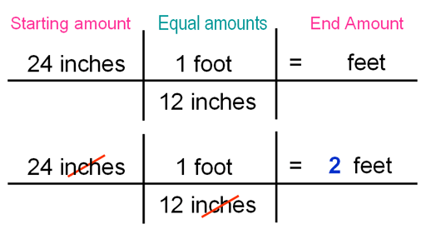
Dimensional Analysis
Dimensional analysis is the process of multiplying by conversion factors to convert between units of measure.

Slide 11
Dimensional Analysis
Convert $480 in.$ to $ft.$ (Example)
$$480 in.$$
$$\frac{1 ft.}{12 in.}$$
$$=\frac{480 ft.}{12}$$
$$=40 ft.$$

Slide 12
Dimensional Analysis
Convert $7.5 gal.$ to $pt.$ (Example)
$$7.5 gal.$$
$$\frac{4 qts.}{1 gal.}$$
$$\frac{2 pts.}{1 qt.}$$
$$=\frac{60 pts.}{1}=60 pts$$

Slide 13
Dimensional Analysis
Convert $65 mph$ to $feet per second$ (Example)
$$\frac{65 mi}{h}$$
$$\frac{5280 ft}{1 mi}$$
$$\frac{1 h}{60 min}$$
$$\frac{1 min}{60 s}$$
$$=\frac{343200 ft}{3600 s}$$
$$=\frac{95.3 ft}{ s}$$

Slide 14
Dimensional Analysis
Convert $36\frac{4}{5} oz$ to $lbs$. (Skill Check)
$$36\frac{4}{5}oz.$$
$$\frac{1 lb.}{16 oz.}$$
$$=\frac{36.8 lb.}{16}$$
$$=2.3 lbs.$$

Slide 15
Dimensional Analysis
Convert $2\frac{1}{2} mi$ to $yds$. (Skill Check)
$$2\frac{1}{2} mi.$$
$$\frac{5280 ft.}{1 mi.}$$
$$\frac{1 yd.}{3 ft.}$$
$$=\frac{13200 yds.}{3}=4400 yds$$

Slide 16
Dimensional Analysis
Convert $24 ft/s$ to $mph$. (Skill Check)
$$\frac{24 ft}{s}$$
$$\frac{1 mi}{5280 ft}$$
$$\frac{60 s}{1 min}$$
$$\frac{60 min}{1 h}$$
$$=\frac{86400 mi}{5280 h}$$
$$=\frac{16.4 mi}{ h}$$

Slide 17
Conversion Tables
The tables in the front cover of the textbook contain directions on what factor to multiply by to convert between the US customary units of measure. The handout I gave you last week include these tables.

Slide 18
Conversion Tables
Convert $460 oz$ to $lbs.$ (Example)
$$460\left(0.0625\right)=28.75 lbs.$$
This is the factor used to convert “from $oz.$” “to $lbs.$”

Slide 19
Conversion Tables
Convert $43. 4 yds$ to $in.$ (Example)
$$43.4\left(36\right)=1562.4 in.$$
This is the factor used to convert “from $yd.$” “to $in.$”

Slide 20
Conversion Tables
Convert $128 oz.$to $pts.$ (Example)
$$128\left(0.125\right)=16 c.$$
$$=16\left(0.5\right)=8 pts.$$
This is the factor used to convert “from $oz.$” “to $c.$”
This is the factor used to convert “from $c$” “to $pts."$

Slide 21
Conversion Tables
Convert $1.5 mi.$to $ft.$ (Skill Check)
$$1.5\left(5280\right)=7920 ft.$$
Convert $45 T.$to $oz.$ (Skill Check)
$$45\left(0.5\right)=22.5 oz.$$

Slide 22
Conversion Tables
Convert $12\frac{3}{4} ft.$to $in.$ (Skill Check)
$$12\frac{3}{4}\left(12\right)=153 in.$$
Convert $4800 oz.$to $gal.$ (Skill Check)
$$4800\left(0.125\right)(0.5)(0.5)(0.25)=37.5 gal.$$

Slide 23
Standard Notation
Measures that contain two or more units of measure are called mixed measures.
Mixed measures are in standard form if the number associated with each unit of measure is less than the number required to convert to the next larger unit.

Slide 24
Standard Notation
Convert $2 ft 20 in$ to standard notation. (Example)
Since there are $12 in$ in $1 ft$, we need to convert the $20 in$ to $ft$ and $in$.
$$1 R 8$$
$$2 ft 20 in=2 ft+1 ft 8 in$$
$12 20$
$$=3 ft 8 in$$

Slide 25
Standard Notation
Convert $5 lb 25 oz$ to standard notation. (Example)
Since there are $16 oz$ in $1 lb$, we need to convert the $25 oz$ to $lb$ and $oz$.
$$1 R 9$$
$$5 lb 25 oz=5 lb+1 lb 9 oz$$
$16 25$
$$=6 lb 9 oz$$

Slide 26
Standard Notation
Convert $3 gal 5 qt 48 oz$ to standard notation. (Example)
Since there are $8 oz$ in $1 c$, we need to convert the $48 oz$ to $c$ and $oz$.
$$6 R 0$$
$$3 gal 5 qt 48 oz=3 gal 5 qt 6 c$$
$8 48$

Slide 27
Standard Notation
Convert $3 gal 5 qt 48 oz$ to standard notation. (Example)
Since there are $2 c$ in $1 pt$, we need to convert the $6 c$ to $pt$ and $c$.
$$3 R 0$$
$$3 gal 5 qt 6 c=3 gal 5 qt 3 pt$$
$2 6$

Slide 28
Standard Notation
Convert $3 gal 5 qt 48 oz$ to standard notation. (Example)
Since there are $2 pt$ in $1 qt$, we need to convert the $3 pt$ to $qt$ and $pt$.
$$1 R 1$$
$$3 gal 5 qt 3 pt=3 gal 5 qt+1 qt 1 pt$$
$2 3$
$$=3 gal 6 qt 1 pt$$

Slide 29
Standard Notation
Convert $3 gal 5 qt 48 oz$ to standard notation. (Example)
Since there are $4 qt$ in $1 gal$, we need to convert the $6 qt$ to $gal$ and q$t$.
$$1 R 2$$
$$3 gal 6 qt 1 pt=3 gal +1 gal 2 qt 1 pt$$
$4 6$
$$=4 gal 2 qt 1 pt$$

Slide 30
Standard Notation
Convert $1 mi 6,375 ft$ to standard notation. (Skill Check)
$$2 mi 1095 ft$$
Convert $5 lb 25 oz$to standard notation. (Skill Check)
$$6 lb 9 oz$$

Slide 31
Standard Notation
After completing an addition, subtraction, multiplication or division on a US customary unit of measure, you should convert the sum, difference, product or quotient to standard form.

Slide 32
Adding US Customary Units
Add: $8 lb 2 oz+7 lb 9 oz$ (Example)
$$8 lbs 2 oz$$
$$+ 7 lbs 9 oz$$
$$15 lbs$$
$$11 oz$$
Since $11 oz<16 oz=1 lb$, this value is in standard form

Slide 33
Adding US Customary Units
Add: $8 gal 3 qt+5 gal 2 qt$(Example)
$$1 gal$$
$$8 gal 3 qt$$
$$+ 5 gal 2 qt$$
$$14 gal$$
$$5 qt$$
$$1 qt$$
Since $5 qt>4 qt=1 gal$, this value is not in standard form.
$$5 qt=1 gal 1 qt$$

Slide 34
Subtracting US Customary Units
Subtract: $3 lb 12 oz−1 lb 9 oz$ (Example)
$$3 lb 12 oz$$
$$− 1 lb 9 oz$$
$$2 lb$$
$$3 oz$$

Slide 35
Subtracting US Customary Units
Subtract: $14 lb 3 oz−9 lb 10 oz$ (Example)
$$16 oz+3 oz$$
$$13 lb$$
$$19 oz$$
$$14 lb 3 oz$$
Since $10 oz>3oz$ we need to borrow from the $lb$ before subtracting.
$$− 9 lb 10 oz$$
$$4 lb$$
$$9 oz$$

Slide 36
Multiplying US Customary Units
Multiply: $7 lb 3 oz ×8.$ (Example)
$$1 lb$$
$$7 lb 3 oz$$
$$× 8$$
$$57 lb$$
$$8 oz$$
$$24 oz$$
Since $24 oz>16 oz=1 lb$, this value is not in standard form.
$$24 oz=1 lb 8 oz$$

Slide 37
Multiplying US Customary Units
Multiply: $12 yd ×23 yd$ (Example)
$$\left(12 yd\right)\left(23yd\right)=276 yd^{2}$$

Slide 38
Dividing US Customary Units
Divide: $20 yd 2 ft 6 in ÷2$ (Example)
$$10 yd$$
$$1 ft$$
$$3 in$$
$$2 20 yd 2 ft 6 in$$

Slide 39
Dividing US Customary Units
Divide: $6 lb 12 oz ÷6 oz$ (Example)
$$\frac{6 lbs 12 oz}{6 oz}$$
$$=\frac{108 oz}{6 oz}$$
$$=18$$
We need to convert the 6 lbs 12 oz to oz.

Slide 40
Operations on US Customary Units
A mixture for hamburgers contains 2 lb 8 oz of ground round steak and 3 lb 10 oz of regular ground beef. How much does the hamburger mixture weigh? (Skill Check)
$$6 lb 2 oz$$

Slide 41
Operations on US Customary Units
A package containing a laser printer weighs 74 lb 3 oz. The container and the packing material weigh 4 lb 12 oz. How much does the laser printer weigh? (Skill Check)
$$69 lb 7 oz$$

Slide 42
Operations on US Customary Units
Tuna is packed in 1 lb 8 oz cans. If a case contains 24 cans, how much does the case weigh? (Skill Check)
$$36 lbs$$

Slide 43
Operations on US Customary Units
A room is to be covered with square linoleum tiles that are 1 ft 1 ft. If the room is 18 ft by 21 ft, how many tiles are needed?(Skill Check)
$$378 tiles$$

Slide 44
Operations on US Customary Units
A roll of No. 14 electrical cable 150 ft long is divided into 30 equal sections. How long is each section?(Skill Check)
$$5 ft$$

Slide 45
Operations on US Customary Units
How many 6 in pieces can be cut from a 48 in pipe?(Skill Check)
$$8 pieces$$

